Slide 1
Azure Kubernetes Service
Trainer: Tonyamol Jose
&
Riant KR

Slide 2
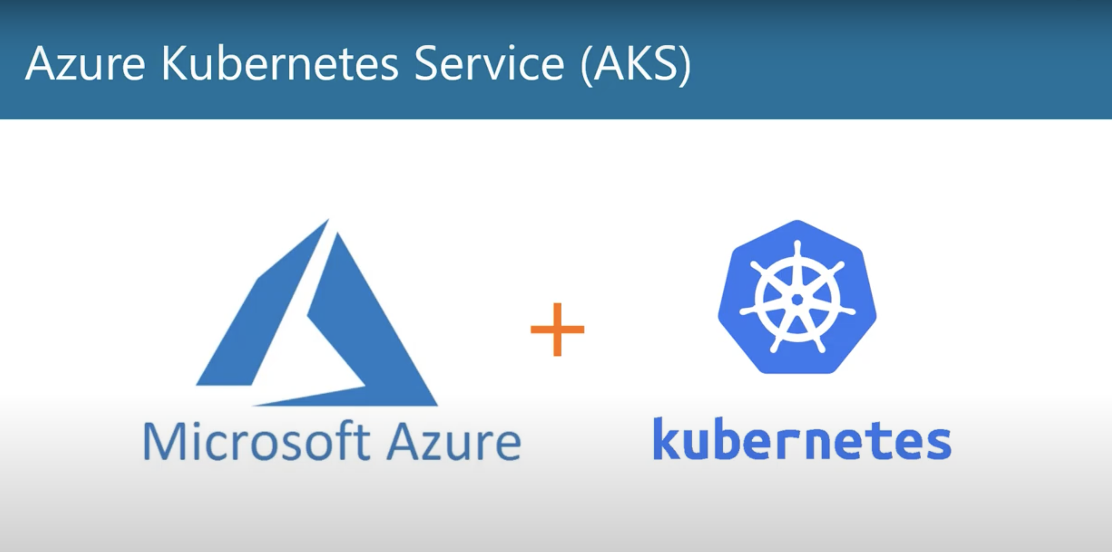

Slide 3
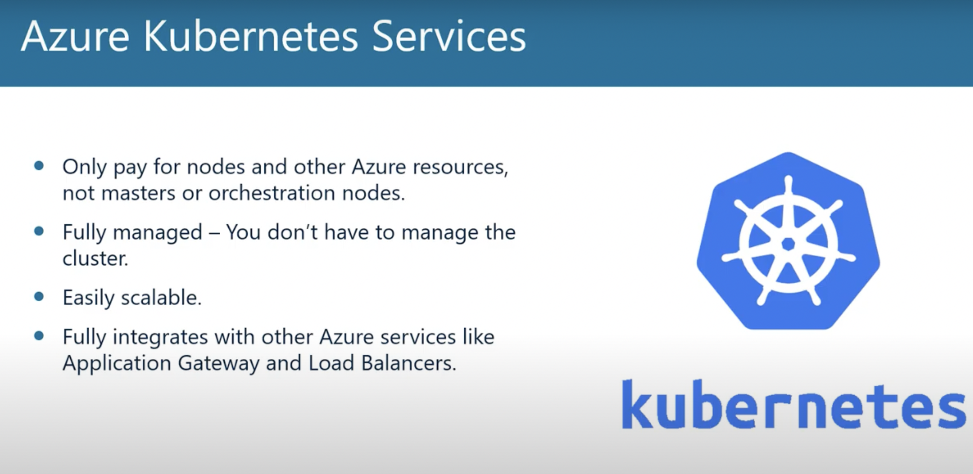
Azure Kubernetes Service offers provisioning, scaling, and upgrades of resources as per requirement or demand without any downtime in the Kubernetes cluster

Slide 4
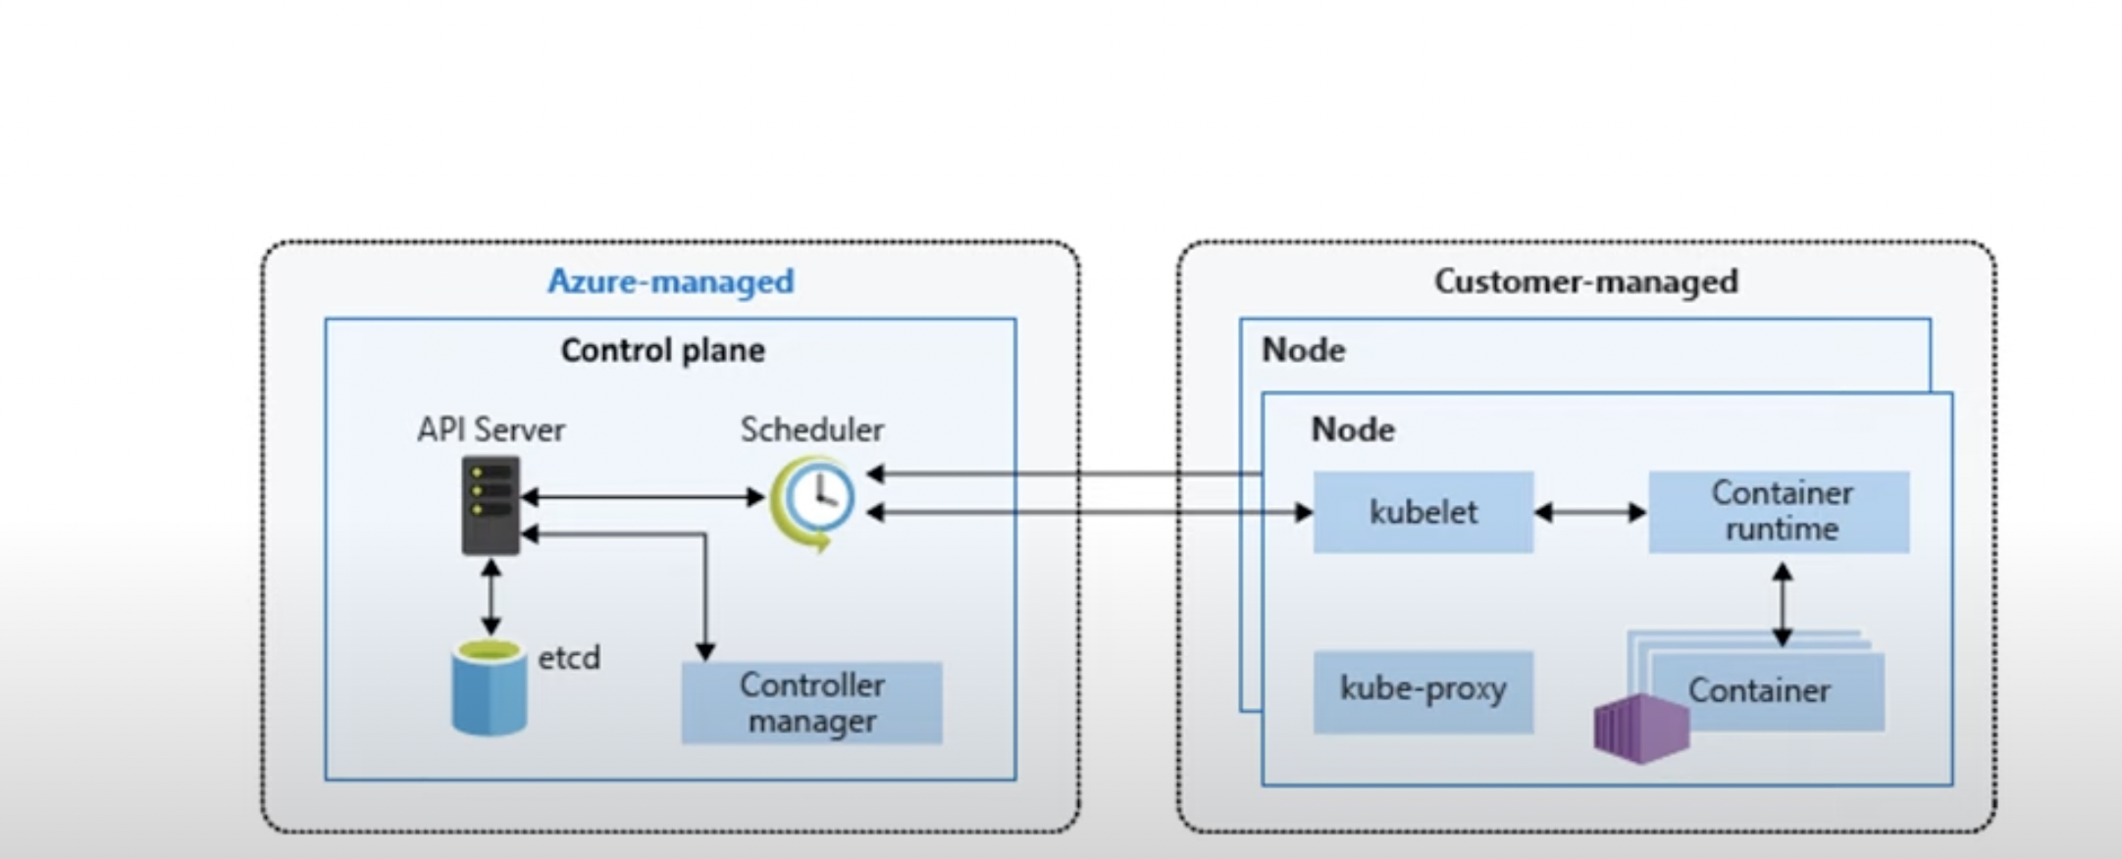
AKS Architecture

Slide 5
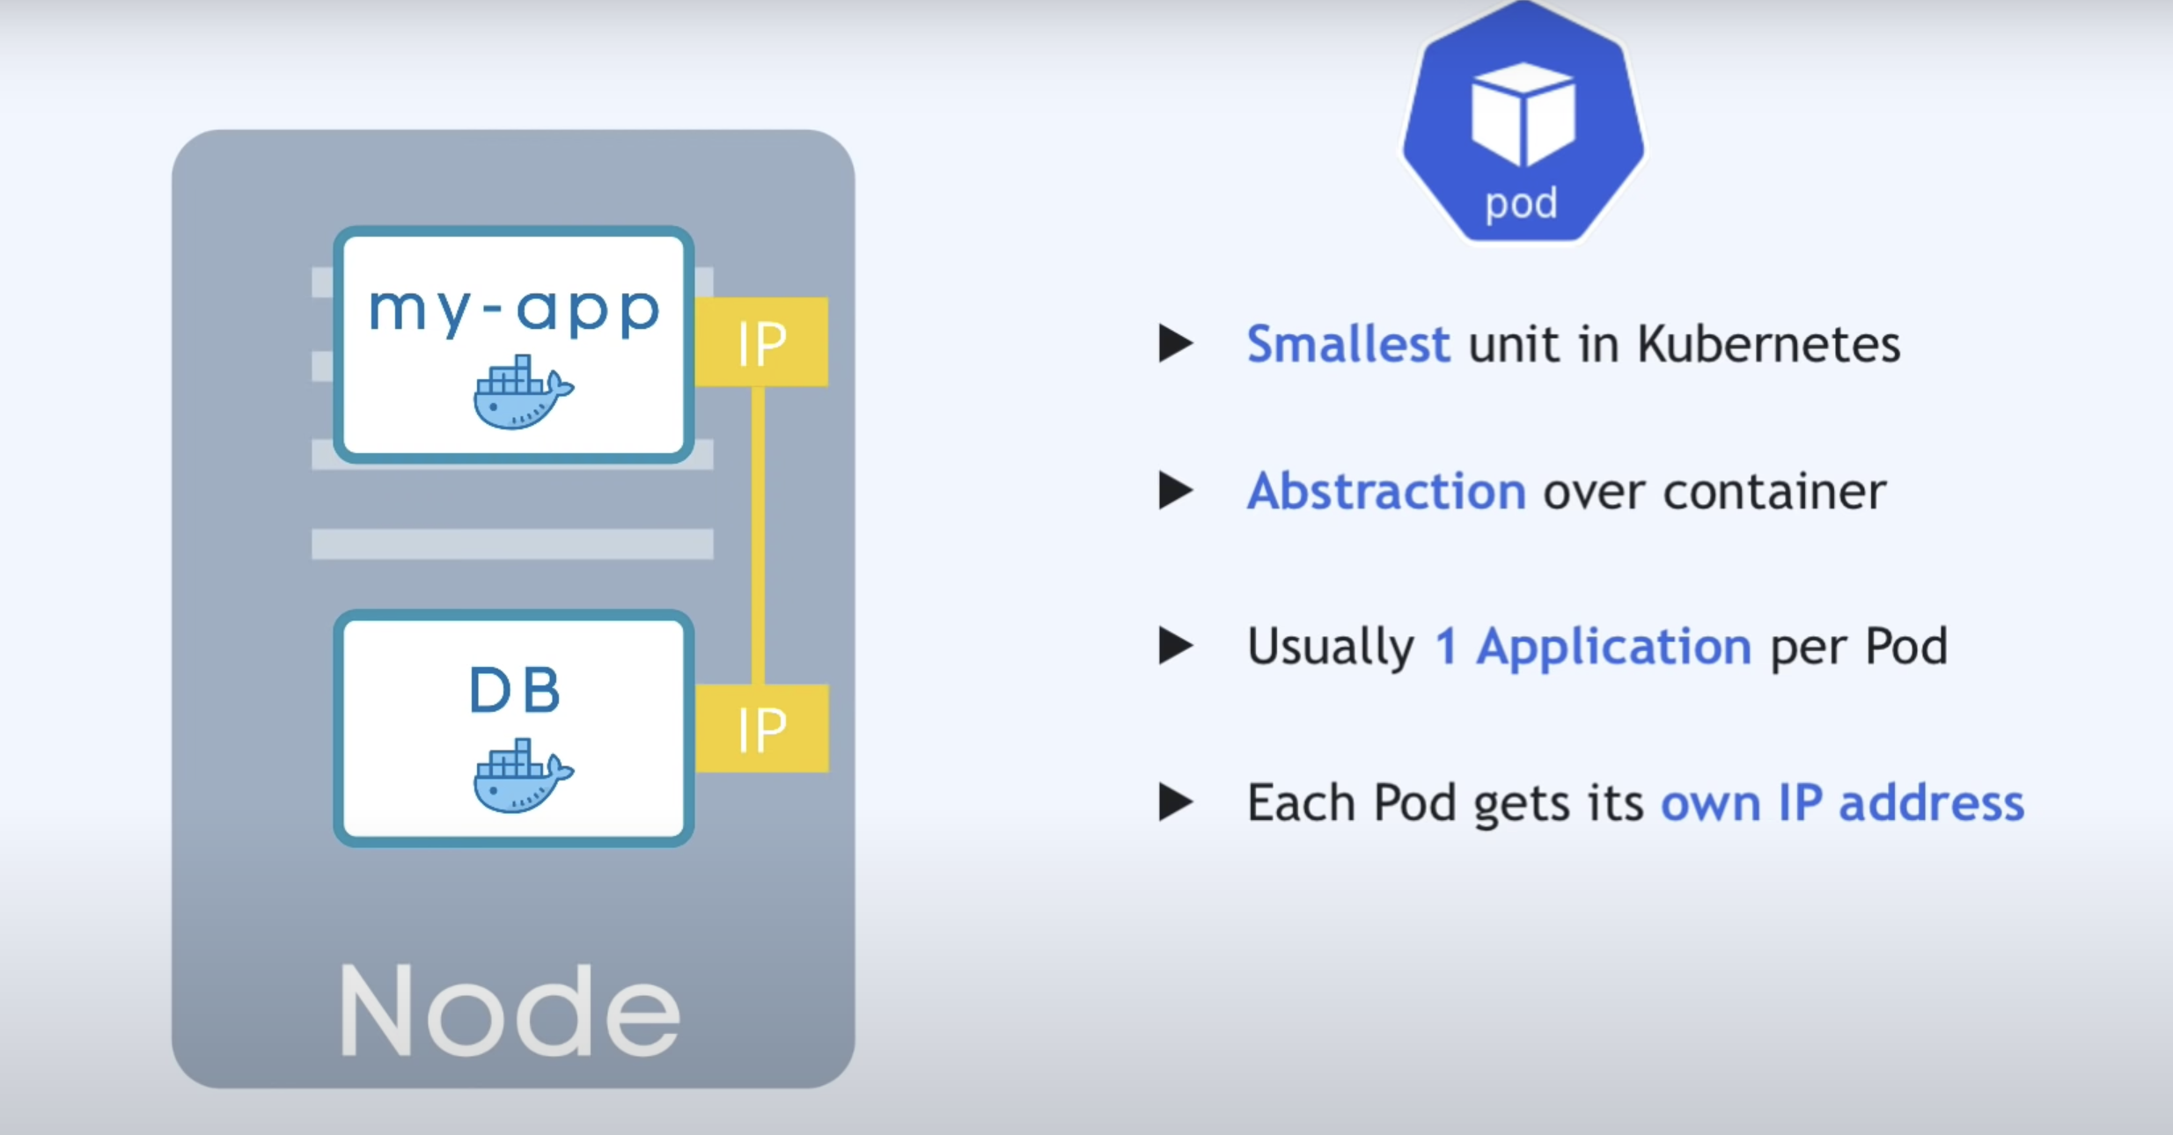
Node and pod

Slide 6
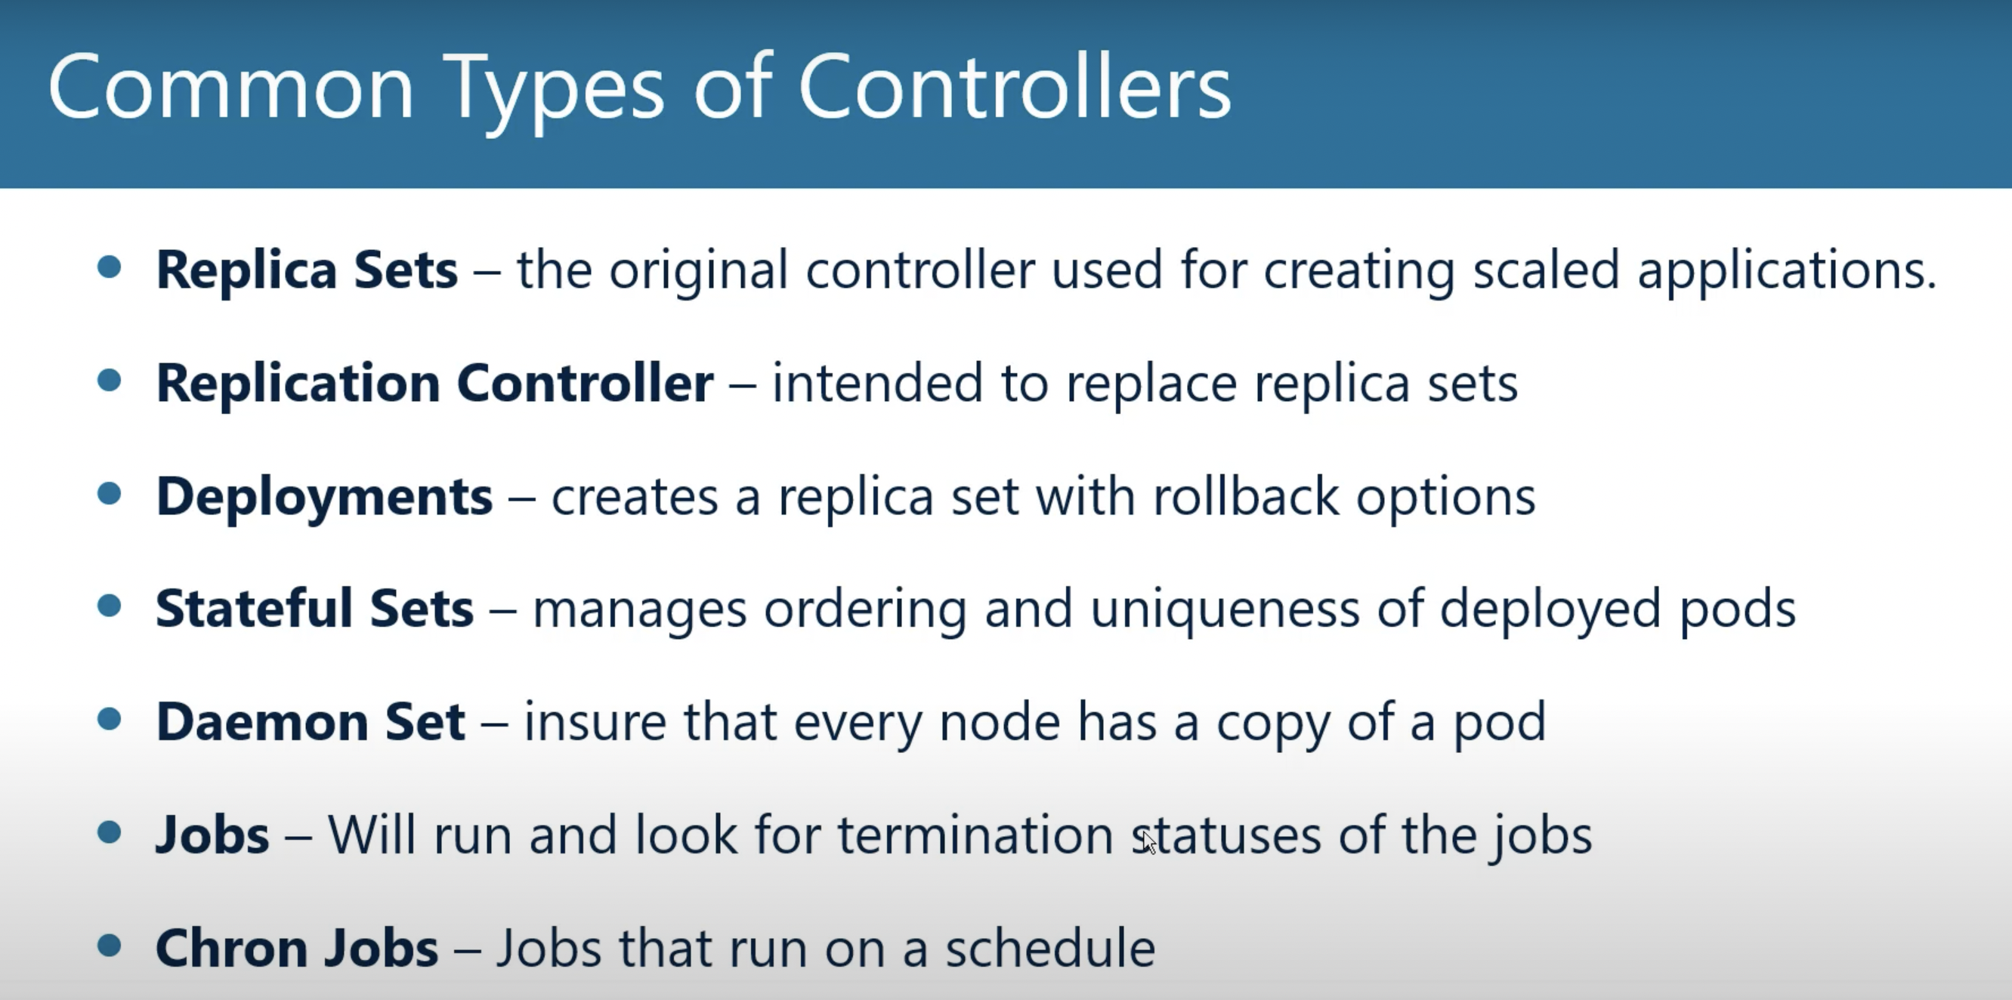

Slide 7
Kubernetes Services
Why we need services?
Service is responsible for exposing an interface to those pods, which enables network access from either within the cluster or between external processes and the service.
Different Service Types
ClusterIP. Exposes a service which is only accessible from within the cluster.
NodePort. Exposes a service via a static port on each node’s IP.
LoadBalancer. Exposes the service via the cloud provider’s load balancer.

Slide 8
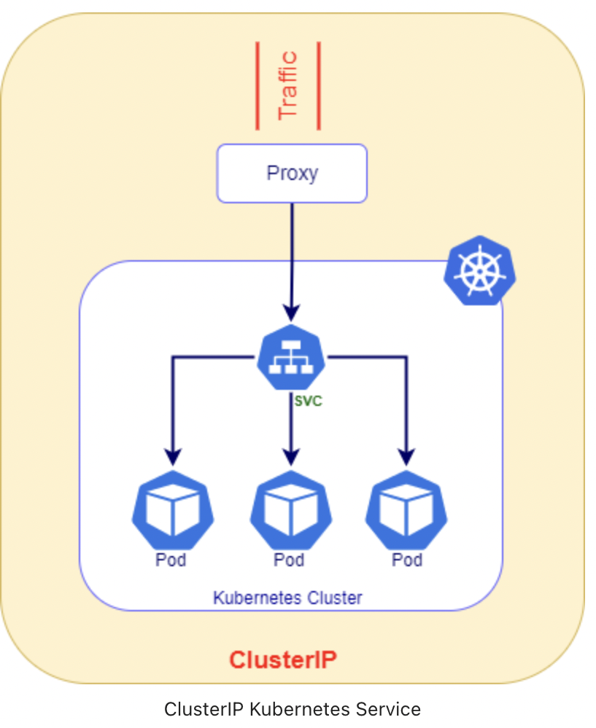
Cluster IP
ClusterIP is the most commonly used service type in Kubernetes
Kubernetes will assign an internal IP to ClusterIP service.
The scope of this service is with in the cluster only and it can’t be accessible
directly from the outside of the Cluster.
To expose these services to outside we need to use ingress controller

Slide 9
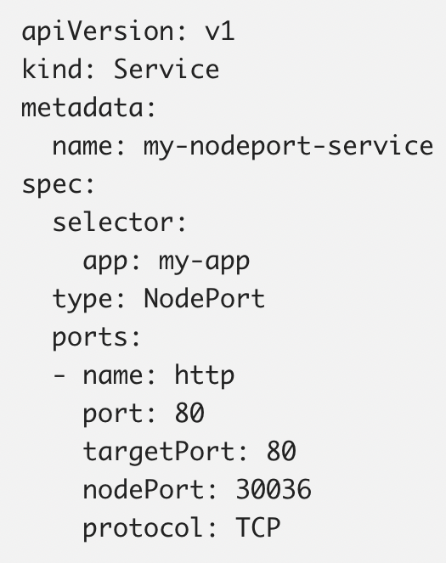
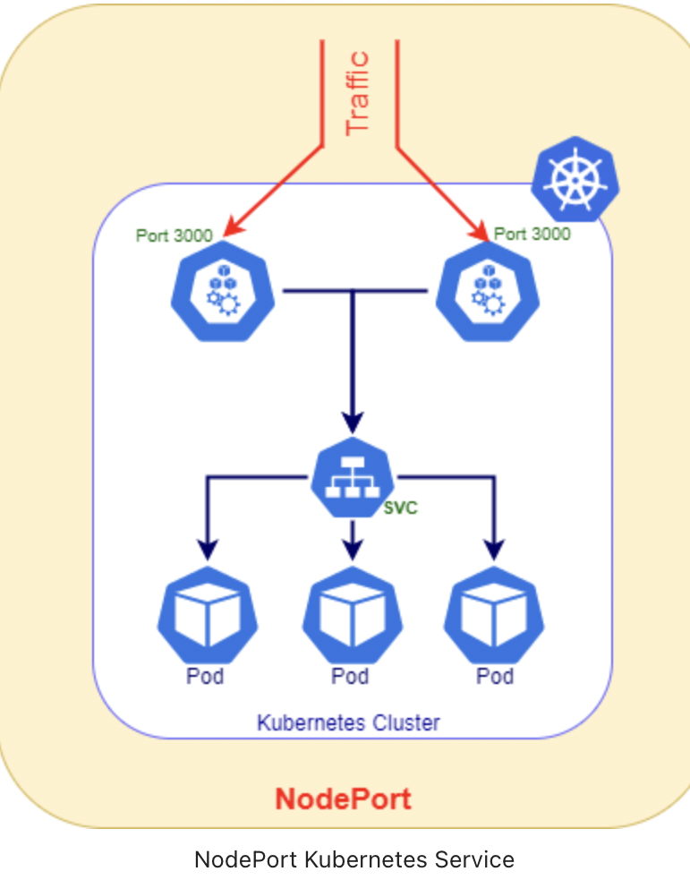
NodePort
Exposes the service on each Node’s IP at a static port (The NodePort). By using, you can access the NodePort service from outside the cluster.
Define random ports between 30000–32767

Slide 10
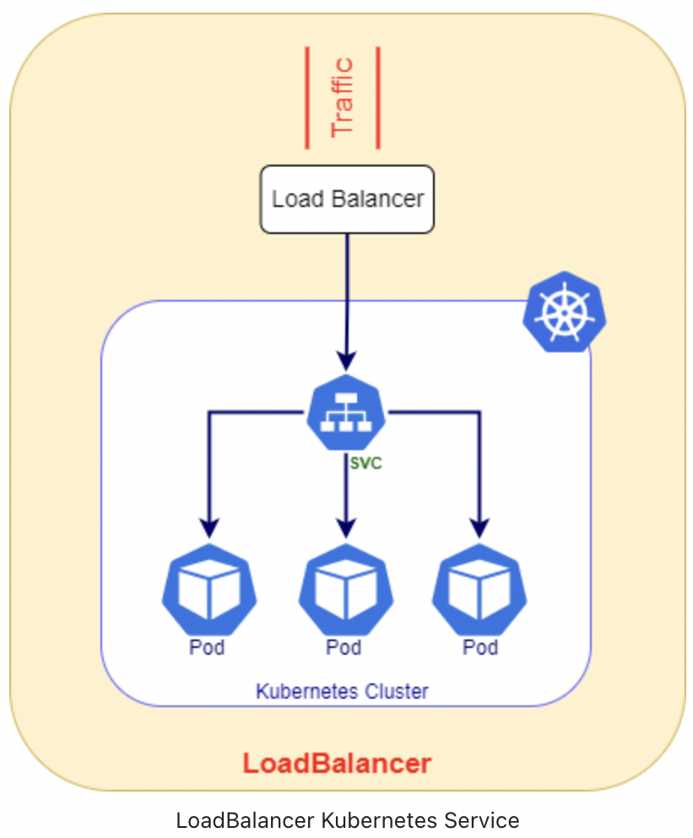
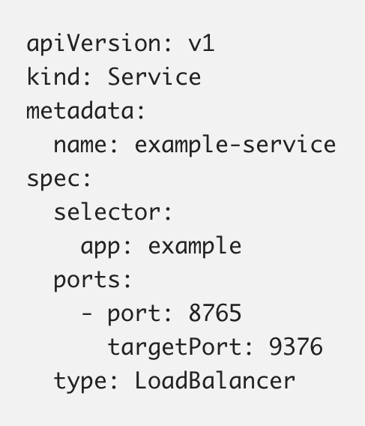
LoadBalancer
A LoadBalancer service is the standard and easiest way of exposing a service to outside the cluster using a Azure load balancer.
All the upcoming request routes to kubernetes services.

Slide 11
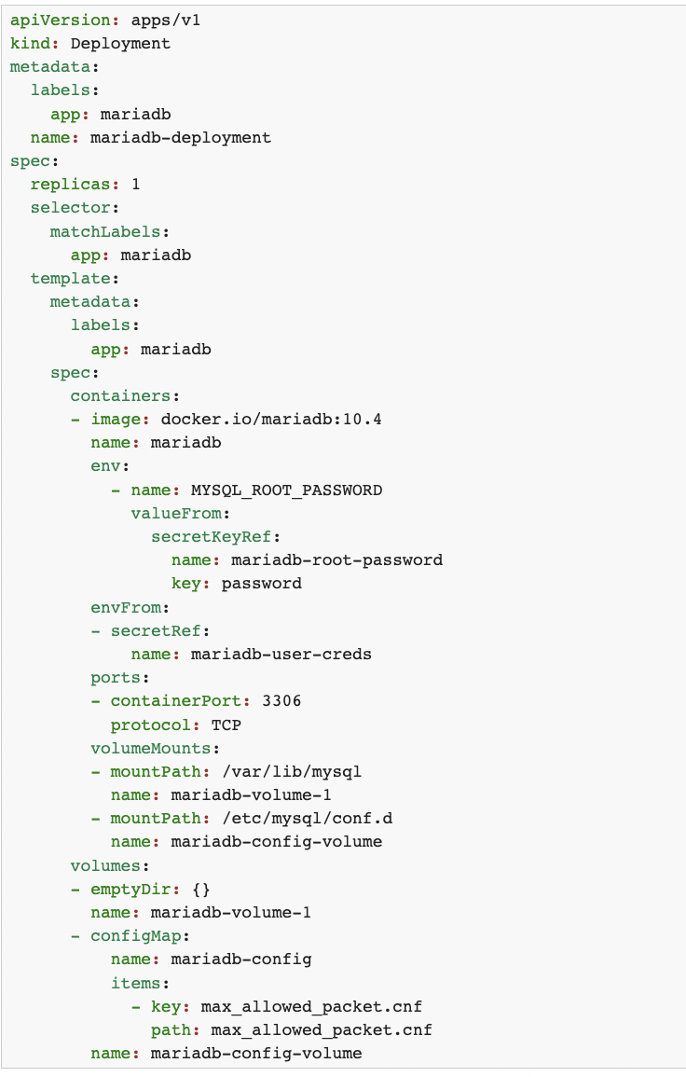
Config maps and secrets
ConfigMap is an API object used to store non-confidential data in key-value pairs. Pods can consume ConfigMaps as environment variables, command-line arguments, or as configuration files in a volume.
ConfigMap does not provide secrecy or encryption.
Secrets are similar to ConfigMaps but are specifically intended to hold confidential data

Slide 12
Node Affinity/pod affinity/anti affinity
Node Affinity
Allowing you to constrain which nodes your Pod can be scheduled on based on node labels. There are two types of node affinity:
requiredDuringSchedulingIgnoredDuringExecution: The scheduler can't schedule the Pod unless the rule is met. This functions like nodeSelector, but with a more expressive syntax.
preferredDuringSchedulingIgnoredDuringExecution: The scheduler tries to find a node that meets the rule. If a matching node is not available, the scheduler still schedules the Pod.
Use the operator field to specify a logical operator for Kubernetes to use when interpreting the rules. You can use In, NotIn, Exists, DoesNotExist, Gt and Lt.
NotIn and DoesNotExist allow you to define node anti-affinity behavior.
Pod Affnity/Anti-Affinity
Allows you to constrain which nodes your Pods can be scheduled on based on the labels of Pods already running on that node, instead of the node labels.
Pod anti-affinity requires nodes to be consistently labelled, in other words, every node in the cluster must have an appropriate label matching topologyKey. If some or all nodes are missing the specified topologyKey label, it can lead to unintended behavior
Similar to Node Affinity are two types of Pod affinity and anti-affinity as follows:
requiredDuringSchedulingIgnoredDuringExecution
preferredDuringSchedulingIgnoredDuringExecution

Slide 13
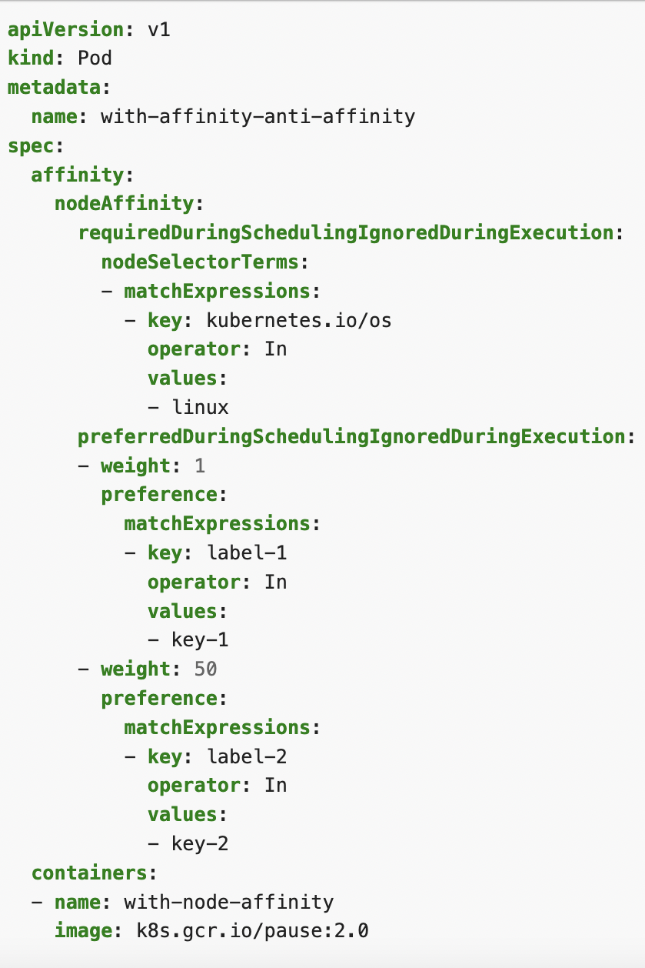
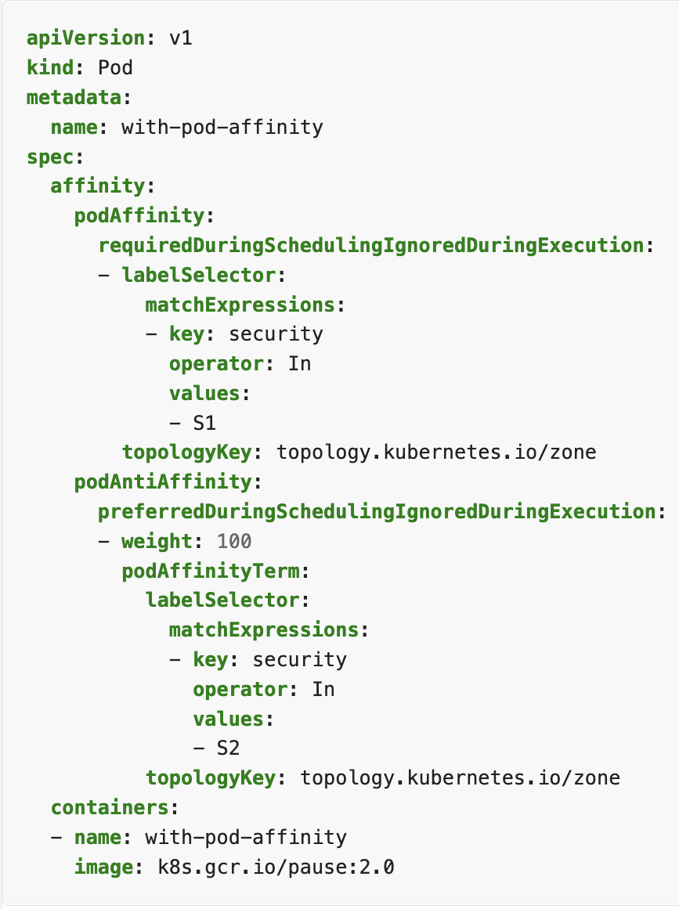
Continues…

Slide 14
Deployments and Statefulsets
Deployments and StatefulSets:
Deployments are used for stateless applications, StatefulSets for stateful applications
The pods in a deployment are interchangeable, whereas the pods in a StatefulSet are not.
Deployments require a service to enable interaction with pods, while a headless service handles the pods’ network ID in StatefulSets.
In a deployment, the replicas all share a volume and PVC, while in a StatefulSet each pod has its own volume and PVC.

Slide 15
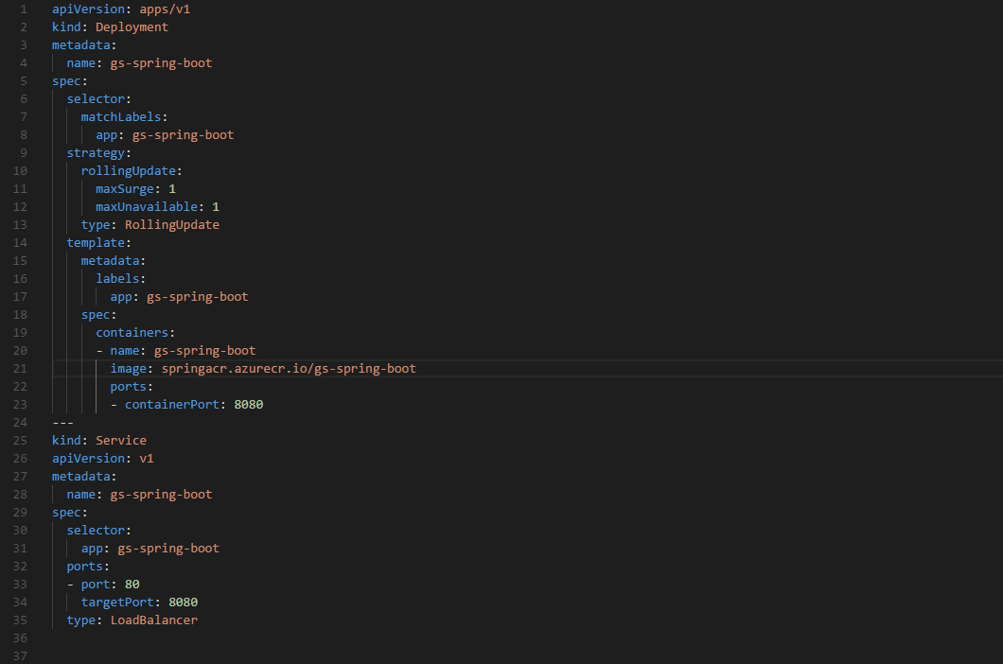
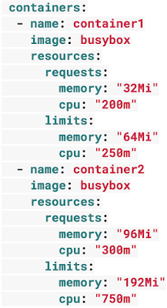
Deployment yaml explained

Slide 16
Autoscaling
Architecting Kubernetes clusters — choosing the best autoscaling strategy
Horizontal Pod Autoscaler : designed to increase the replicas in your deployments.
Vertical Pod Autoscaler : Useful when you can't create more copies of your Pods, but you still need to handle more traffic
Cluster Autoscaler : When your cluster runs low on resources, the Cluster Autoscaler provision a new compute unit and adds it to the cluster. If there are too many empty nodes, the cluster autoscaler will remove them to reduce costs

Slide 17
Azure Container registry
Build, store, secure, scan, replicate, and manage container images and artifacts
Automate container image builds and maintenance with ACR Tasks

Slide 18
Day 2

